Slide 1
Quicksort - Randomized
Comp 122, Spring 2004

Slide 2
Quicksort: review
Quicksort(A, p, r)
if p < r then
q := Partition(A, p, r);
Quicksort(A, p, q – 1);
Quicksort(A, q + 1, r)
fi
Partition(A, p, r)
x, i := A[r], p – 1;
for j := p to r – 1 do
if A[j] ≤ x then
i := i + 1;
A[i] ↔ A[j]
fi
od;
A[i + 1] ↔ A[r];
return i + 1
A[p..r]
5
A[p..q – 1]
A[q+1..r]
Partition
5
≤ 5
≥ 5
Comp 122

Slide 3
Worst-case Partition Analysis
Recursion tree for
worst-case partition
n
Split off a single element at each level:
T(n) = T(n – 1) + T(0) + PartitionTime(n)
= T(n – 1) + Θ(n)
= ∑_{k=1 to n}Θ(k)
= Θ(∑_{k=1 to n} k )
= Θ(n²)
n – 1
n – 2
n
n – 3
2
1
Comp 122

Slide 4
Best-case Partitioning
cn
Each subproblem size ≤ n/2.
Recurrence for running time
  T(n) ≤ 2T(n/2) + PartitionTime(n)
  = 2T(n/2) + Θ(n)
T(n) = Θ(n lg n)
cn/2
cn/2
lg n
cn/4
cn/4
cn/4
cn/4
c
c
c
c
c
c
Comp 122

Slide 5
Variations
Quicksort is not very efficient on small lists.
This is a problem because Quicksort will be called on lots of small lists.
Fix 1: Use Insertion Sort on small problems.
Fix 2: Leave small problems unsorted. Fix with one final Insertion Sort at end.
  Note: Insertion Sort is very fast on almost-sorted lists.
Comp 122

Slide 6
Randomized Quicksort
Want to make running time independent of input ordering.
How can we do that?
  Make the algorithm randomized.
  Make every possible input equally likely.
    Can randomly shuffle to permute the entire array.
    For quicksort, it is sufficient if we can ensure that every element is equally likely to be the pivot.
    So, we choose an element in A[p..r] and exchange it with A[r].
    Because the pivot is randomly chosen, we expect the partitioning to be well balanced on average.
Comp 122

Slide 7
Variations (Continued)
Input distribution may not be uniformly random.
Fix 1: Use “randomly” selected pivot.
  We’ll analyze this in detail.
Fix 2: Median-of-three Quicksort.
  Use median of three fixed elements (say, the first, middle, and last) as the pivot.
  To get O(n²) behavior, we must continually be unlucky to see that two out of the three elements examined are among the largest or smallest of their sets.
Comp 122

Slide 8
Randomized Version
Want to make running time independent of input ordering.
Randomized-Partition(A, p, r)
i := Random(p, r);
A[r] ↔ A[i];
Partition(A, p, r)
Randomized-Quicksort(A, p, r)
if p < r then
q := Randomized-Partition(A, p, r);
Randomized-Quicksort(A, p, q – 1);
Randomized-Quicksort(A, q + 1, r)
fi
Comp 122

Slide 9
Probabilistic Analysis and Randomized Algorithms
Comp 122, Spring 2004

Slide 10
The Hiring Problem
You are using an employment agency to hire a new assistant.
The agency sends you one candidate each day.
You interview the candidate and must immediately decide whether or not to hire that person. But if you hire, you must also fire your current office assistant—even if it’s someone you have recently hired.
Cost to interview is c_{i} per candidate.
Cost to hire is c_{h} per candidate.
You want to have, at all times, the best candidate seen so far.
When you interview a candidate who is better than your current assistant, you fire the current assistant and hire the candidate.
You will always hire the first candidate that you interview.
Problem: What is the cost of this strategy?
Comp 122

Slide 11
Pseudo-code to Model the Scenario
Hire-Assistant (n)
best ← 0 ;;Candidate 0 is a least qualified sentinel candidate
for i ← 1 to n
do interview candidate i
if candidate i is better than candidate best
then best ← i
hire candidate i
Cost Model: Slightly different from the model considered so far.
However, analytical techniques are the same.
Want to determine the total cost of hiring the best candidate.
If n candidates interviewed and m hired, then cost is nc_{i}+mc_{h}.
Have to pay nc_{i} to interview, no matter how many we hire.
So, focus on analyzing the hiring cost mc_{h}.
m varies with order of candidates.
Comp 122

Slide 12
Worst-case Analysis
In the worst case, we hire all n candidates.
This happens if each candidate is better than all those who came before. Candidates come in increasing order of quality.
Cost is nc_{i}+nc_{h}.
If this happens, we fire the agency. What should happen in the typical or average case?
Comp 122

Slide 13
Probabilistic Analysis
We need a probability distribution of inputs to determine average-case behavior over all possible inputs.
For the hiring problem, we can assume that candidates come in random order.
  Assign a rank rank(i), a unique integer in the range 1 to n to each candidate.
  The ordered list ⟨rank(1), rank(2), …, rank(n)⟩ is a permutation of the candidate numbers ⟨1, 2, …, n⟩.
  Let’s assume that the list of ranks is equally likely to be any one of the n! permutations.
  The ranks form a uniform random permutation.
  Determine the number of candidates hired on an average, assuming the ranks form a uniform random permutation.
Comp 122

Slide 14
Randomized Algorithm
Impose a distribution on the inputs by using randomization within the algorithm.
Used when input distribution is not known, or cannot be modeled computationally.
For the hiring problem:
  We are unsure if the candidates are coming in a random order.
  To make sure that we see the candidates in a random order, we make the following change.
    The agency sends us a list of n candidates in advance.
    Each day, we randomly choose a candidate to interview.
  Thus, instead of relying on the candidates being presented in a random order, we enforce it.
Comp 122

Slide 15
Discrete probability = counting
The language of probability helps count all possible outcomes.
Definitions:
  Random Experiment (or Process)
    Result (outcome) is not fixed. Multiple outcomes are possible.
    Ex: Throwing a fair die.
  Sample Space S
    Set of all possible outcomes of a random experiment.
    Ex: {1, 2, 3, 4, 5, 6} when a die is thrown.
  Elementary Event
    A possible outcome, element of S, x ∈ S;
    Ex: 2 – Throw of fair die resulting in 2.
  Event E
    Subset of S, E ⊆ S;
    Ex: Throw of die resulting in {x > 3} = {4, 5, 6}
  Certain event : S
  Null event : φ
  Mutual Exclusion
    Events A and B are mutually exclusive if A∩B= φ.
Comp 122

Slide 16
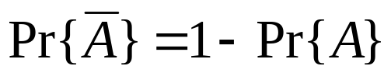
Axioms of Probability & Conclusions
A probability distribution Pr{} on a sample space S is a mapping from events of S to real numbers such that the following are satisfied:
  Pr{A} ≥ 0 for any event A.
  Pr{S} = 1. (Certain event)
  For any two mutually exclusive events A and B,
  Pr(A∪B ) = Pr(A)+Pr(B).
Conclusions from these axioms:
  Pr{φ} = 0.
  If A ⊆ B, then Pr{A} ≤ Pr{B}.
  Pr(A∪B ) = Pr(A)+Pr(B)-Pr(A∩B) ≤ Pr(A)+Pr(B)
Comp 122

Slide 17
Independent Events
Events A and B are independent if
  Pr{A|B} = Pr{A}, if Pr{B} != 0
  i.e., if Pr{A∩B} = Pr{A}Pr{B}
Example: Experiment: Rolling two independent dice.
Event A: Die 1 < 3
Event B: Die 2 > 3
A and B are independent.
Comp 122

Slide 18
Conditional Probability
Example: On the roll of two independent dice, what is the probability of a total of 8?
  S = {(1,1), (1,2), … , (6,6)}
  |S| = 36
  A = {(2,6), (3,5), (4,4), (5,3), (6,2)}
  Pr{A} = 5/36
Comp 122

Slide 19
Conditional Probability
Example: On the roll of two independent dice, if at least one face is known to be an even number, what is the probability of a total of 8?
  One die is even, sum is 8 ⇒ Second die is also even.
  No. of elementary events in the original sample space: 36
  The fact that one face is even, precludes outcomes where both faces are odd.
  Hence, sample space size is reduced to 27 (9 elementary events have both odd faces).
  Number of elementary events in the reduced sample space that are successes : 3 --{(2,6), (4,4), (6,2)}
  Hence, Probability is 3/27 = 1/9.
Comp 122

Slide 20
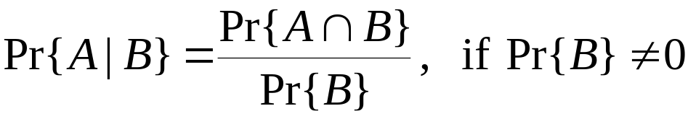
Conditional Probability
Formalizes the notion of having prior partial knowledge of the outcome of an experiment.
The conditional probability of an event A given that another event B occurs is defined to be
In the previous example
  A: Event that sum on the faces is 8.
  B: Event that one of them is even.
  Pr{B} = 27/36
  Pr{A∩B} = 3/36
  Pr{A|B} = Pr {A∩B}/Pr{B} = 3/27 = 1/9.
Comp 122

Slide 21
Discrete Random Variables
A random variable X is a function from a sample space S to the real numbers.
If the space is finite or countably infinite, a random variable X is called a discrete random variable.
Maps each possible outcome of an experiment to a real number.
For a random variable X and a real number x, the event X=x is {s∈S : X(s)=x}.
Pr{X=x} = ∑{s∈S:X{s}=x}Pr{s}
f(x) = Pr{X=x} is the probability density function of the random variable X.
Comp 122

Slide 22
Discrete Random Variables
Example:
  Rolling 2 dice.
  X: Sum of the values on the two dice.
  Pr{X=7} = Pr{(1,6),(2,5),(3,4),(4,3),(5,2),(6,1)}
  = 6/36 = 1/6.
Comp 122

Slide 23
Expectation
Average or mean
The expected value of a discrete random variable X is E[X] = ∑_{x} x Pr{X=x}
Linearity of Expectation
  E[X+Y] = E[X]+E[Y], for all X, Y
  E[aX+Y]=aE[X]+E[Y], for constant a and all X, Y
For mutually independent random variables X₁, X₂, …, X_{n}
  E[X₁X₂ … X_{n}] = E[X₁]E[X₂]…E[X_{n}]
Comp 122

Slide 24
Expectation – Example
Let X be the RV denoting the value obtained when a fair die is thrown. What will be the mean of X, when the die is thrown n times.
  Let X₁, X₂, …, X_{n} denote the values obtained during the n throws.
  The mean of the values is (X₁+X₂+…+X_{n})/n.
  Since the probability of getting values 1 thru 6 is (1/6), on an average we can expect each of the 6 values to show up (1/6)n times.
  So, the numerator in the expression for mean can be written as (1/6)n·1+(1/6)n·2+…+(1/6)n·6
  The mean, hence, reduces to (1/6)·1+(1/6)·2+…(1/6)·6,
  which is what we get if we apply the definition of expectation.
Comp 122

Slide 25
Randomized Hire-Assistant
Randomized-Hire-Assistant (n)
Randomly permute the list of candidates
best ← 0 ;;Candidate 0 is a least qualified dummy candidate
for i ← 1 to n
do interview candidate i
if candidate i is better than candidate best
then best ← i
hire candidate i
How many times do you find a new maximum?
Comp 122

Slide 26
Analysis of the Hiring Problem
(Probabilistic analysis of the deterministic algorithm)
X – RV that denotes the number of times we hire a new office assistant.
Define indicator RV’s X₁, X₂, …, X_{n}.
X_{i} = I{candidate i is hired}.
As in the previous example,
  X = X₁ + X₂ + …+ X_{n}
  Need to compute Pr{candidate i is hired}.
Pr{candidate i is hired}
  i is hired only if i is better than 1, 2,…,i-1.
  By assumption, candidates arrive in random order
    Candidates 1, 2, …, i arrive in random order.
    Each of the i candidates has an equal chance of being the best so far.
    Pr{candidate i is the best so far} = 1/i.
    E[X_{i}] = 1/i. (By Lemma 5.1)
Comp 122

Slide 27
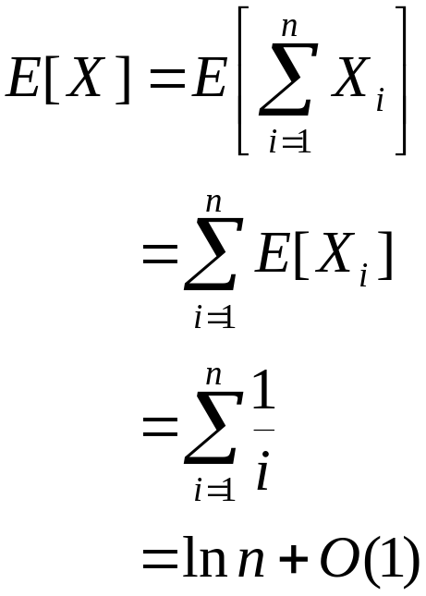
Analysis of the Hiring Problem
Compute E[X], the number of candidates we expect to hire.
By Equation (A.7) of the sum of
a harmonic series.
Expected hiring cost = O(c_{h}ln n).
Comp 122

Slide 28
Analysis of the randomized hiring problem
Permutation of the input array results in a situation that is identical to that of the deterministic version.
Hence, the same analysis applies.
Expected hiring cost is hence O(c_{h}ln n).
Comp 122

Slide 29
Quicksort - Randomized
Comp 122, Spring 2004

Slide 30
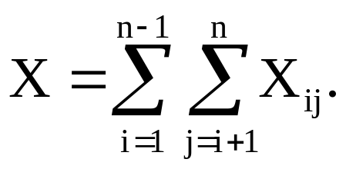
Avg. Case Analysis of Randomized Quicksort
Let RV X = number of comparisons over all calls to Partition.
Suffices to compute E[X]. Why?
Notation:
  Let z₁, z₂, …, z_{n} denote the list items (in sorted order).
  Let Z_{ij} = {z_{i}, z_{i+1}, …, z_{j}}.
Let RV X_{ij} =
Thus,
1 if z_{i} is compared to z_{j}
0 otherwise
X_{ij} is an
indicator random variable.
X_{ij}=I{z_{i} is compzred to z_{j}}.
Comp 122

Slide 31
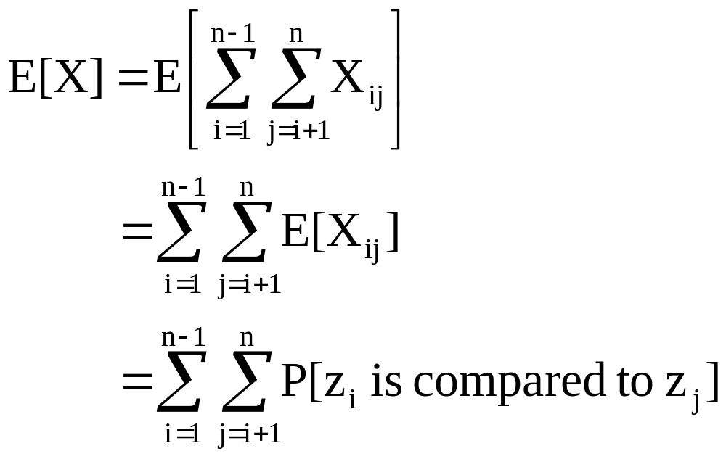
Analysis (Continued)
We have:
Note:
E[X_{ij}] = 0·P[X_{ij}=0] + 1·P[X_{ij}=1]
= P[X_{ij}=1]
This is a nice property of
indicator RVs. (Refer to notes on Probabilistic Analysis.)
So, all we need to do is to compute P[z_{i} is compared to z_{j}].
Comp 122

Slide 32
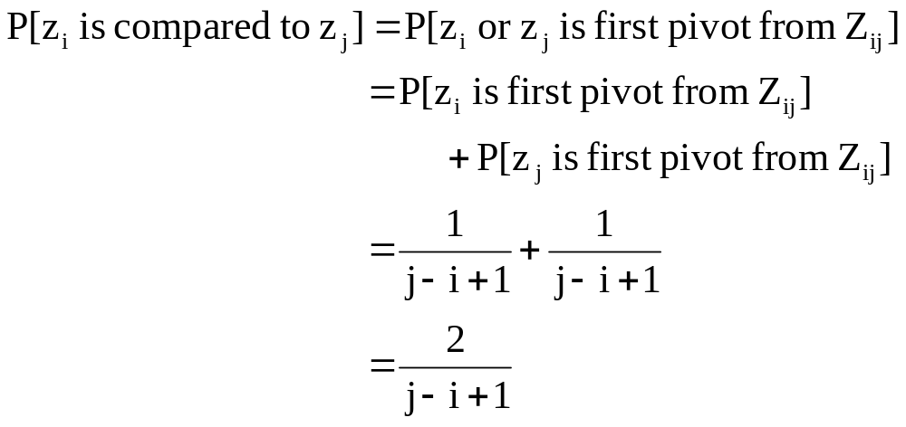
Analysis (Continued)
z_{i} and z_{j} are compared iff the first element to be chosen as a pivot
from Z_{ij} is either z_{i} or z_{j}.
Exercise: Prove this.
So,
Comp 122

Slide 33
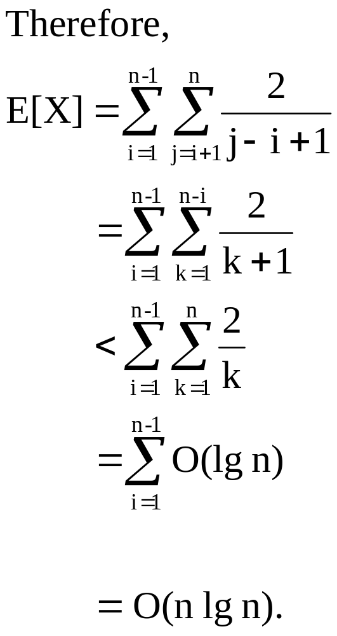
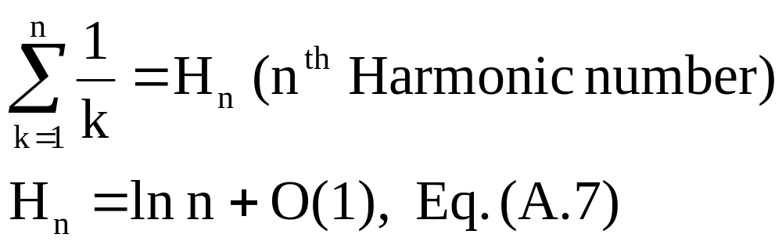
Analysis (Continued)
Substitute k = j – i.
Comp 122

Slide 34
Deterministic vs. Randomized Algorithms
Deterministic Algorithm : Identical behavior for different runs for a given input.
Randomized Algorithm : Behavior is generally different for different runs for a given input.
Algorithms
Deterministic
Randomized
Worst-case
Analysis
Probabilistic
Analysis
Probabilistic
Analysis
Worst-case
Running Time
Average
Running Time
Average
Running Time
Comp 122

